Slide 1
Python Sorting, Tuples, and List Comprehensions
January 2026

Slide 2
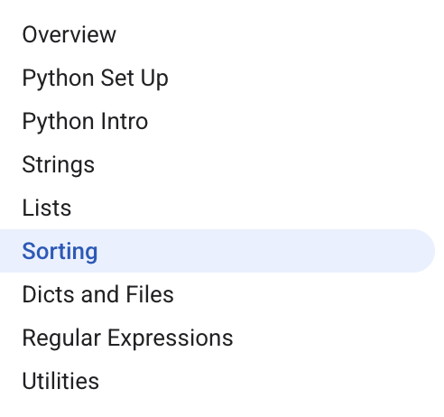
Curriculum Checkpoint
We are at the Halfway Mark.
Each topic takes about 2 sessions. 1 session a week.
Estimate end of March to complete this introductory course.
Then the fun begins.
Optional Online Certification Exam that can be taken at any time and unlimited times (once a month max).

Slide 3
The Objective of Learning Python for AI Practitioners
You are not training to become software engineers.
You do not need to memorize advanced algorithms that takes years of training. The AI can help take care of that.
You are training to become business-technical hybrid unicorns.
Keep your business skills relevant.
Python knowledge will help with:
Advanced experimentation with AI and machine learning
Building AI agents using Python and vibe-coding with clear understanding of what you’re building.
Intuition of how software works and other technical topics
Debugging and managing coding agents made easier

Slide 4
Sorting

Slide 5
Sorting Lists with sorted()
• The simplest way to sort values in Python is to use the sorted() function, which takes a collection of items and returns a new list in sorted order.
◦ Returns a new list
◦ Does not modify the original collection
• Because sorted() creates a new list, you can safely sort data for display or calculation without changing the original list that might be needed later.
◦ Useful for debugging and reporting
◦ Avoids unintended side effects
• Even though sorted() is most commonly used with lists, it can accept any iterable, meaning many “things you can loop over” can be sorted into a list.
◦ Iterable examples: lists, tuples, strings
◦ Result is always a list

Slide 6
Code Example: Basic sorted() returns a new list
a = [5, 1, 4, 3]
print(sorted(a)) ## [1, 3, 4, 5]
print(a) ## [5, 1, 4, 3]

Slide 7
Sorting in Reverse and Understanding Case Sensitivity
• The sorted() function supports optional arguments that change how sorting behaves, allowing you to control details like whether the ordering is ascending or descending.
◦ Optional arguments customize behavior
• If you pass reverse=True to sorted(), Python sorts the values in the opposite order, which is a quick way to get a descending sort without extra steps.
◦ Example: sorted(items, reverse=True)
• When sorting strings with default settings, Python compares characters based on their underlying character codes, so uppercase letters come before lowercase letters in many cases.
◦ This is why 'BB' can appear before 'aa'

Slide 8
Code Example: reverse=True and default string ordering
strs = ['aa', 'BB', 'zz', 'CC']
print(sorted(strs)) ## ['BB', 'CC', 'aa', 'zz'] (case sensitive)
print(sorted(strs, reverse=True)) ## ['zz', 'aa', 'CC', 'BB']

Slide 9
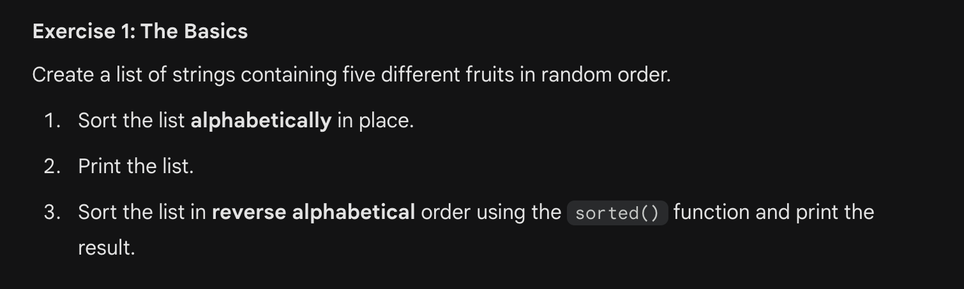
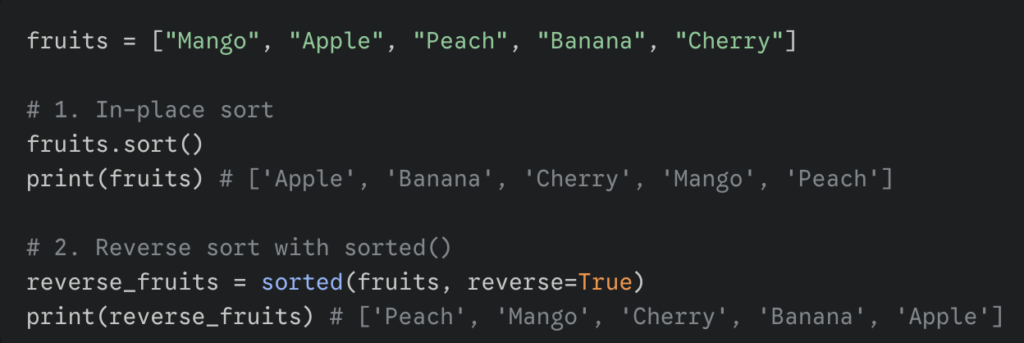

Slide 10
Custom Sorting with key= (Using a “Proxy” Value)
• For more complex sorting, sorted() accepts a key= argument that names a function used to transform each item into a comparison value before ordering.
◦ The key function runs once per element
• The key function must take exactly one value and return exactly one value, and Python sorts by those returned values rather than directly comparing the original objects.
◦ Returned value is a “proxy” for sorting
• A common and easy key function is len, which sorts strings by their length, producing an ordering from shortest string to longest string without writing custom code.
◦ len is a built-in function
◦ Often used for text lists

Slide 11
Code Example: Sorting strings by length with key=len
strs = ['ccc', 'aaaa', 'd', 'bb']
print(sorted(strs, key=len)) ## ['d', 'bb', 'ccc', 'aaaa']

Slide 12
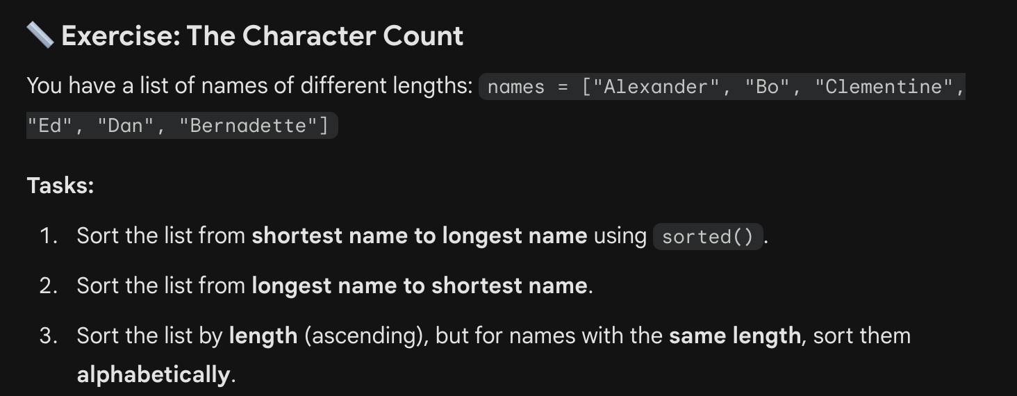
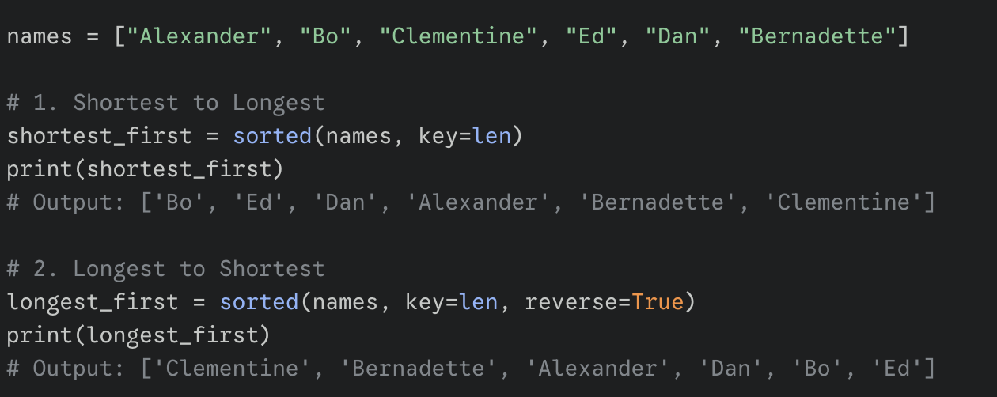

Slide 13
Case-Insensitive Sorting with key=str.lower
• If you want sorting to treat uppercase and lowercase letters the same, you can use a key function that converts each string to a consistent form before comparison.
◦ Common approach: convert to lowercase
• Using key=str.lower tells sorted() to compare strings using each string’s lowercase version, while still returning the original strings in their original capitalization.
◦ Comparison uses lowercase “proxy” values
◦ Returned list keeps original strings
• This approach is often easier than manually converting strings and then trying to map results back, because sorted() handles the transformation and ordering in one step.
◦ One-step customization
◦ Keeps original data intact

Slide 14
Code Example: Case-insensitive sort using str.lower
## "key" argument specifying str.lower function to use for sorting
print(sorted(strs, key=str.lower)) ## ['aa', 'BB', 'CC', 'zz']

Slide 15
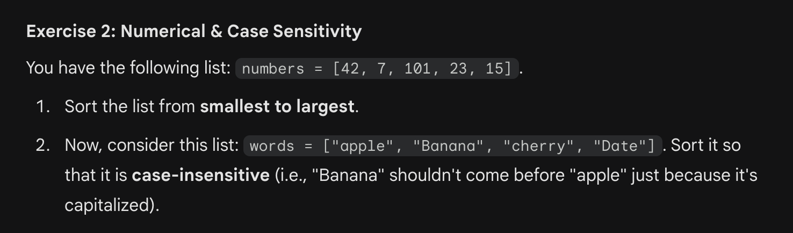
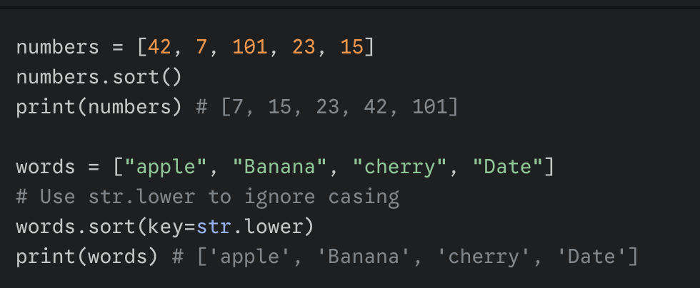

Slide 16
Writing Your Own key Function for Custom Rules
• When built-in key functions are not enough, you can define your own function and pass it with key= so Python sorts according to the rule you encode.
◦ Your function must take one argument
◦ Your function must return one value
• A practical example is sorting strings by their last character, where the key function returns s[-1], and the sorting compares those last-letter proxy values.
◦ s[-1] means “last character”
◦ Works well for consistent string formats
• This pattern is widely useful because it separates “how to measure an item for sorting” from the sorting operation itself, keeping your code easier to read and test.
◦ Clear separation of concerns
◦ Reusable key functions

Slide 17
Start Next Session Here

Slide 18
Code Example: Custom key function to sort by last letter
## Say we have a list of strings we want to sort by the last letter of the string.
strs = ['xc', 'zb', 'yd' ,'wa']
## Write a little function that takes a string, and returns its last letter.
## This will be the key function (takes in 1 value, returns 1 value).
def MyFn(s):
return s[-1]
## Now pass key=MyFn to sorted() to sort by the last letter:
print(sorted(strs, key=MyFn)) ## ['wa', 'zb', 'xc', 'yd']

Slide 19
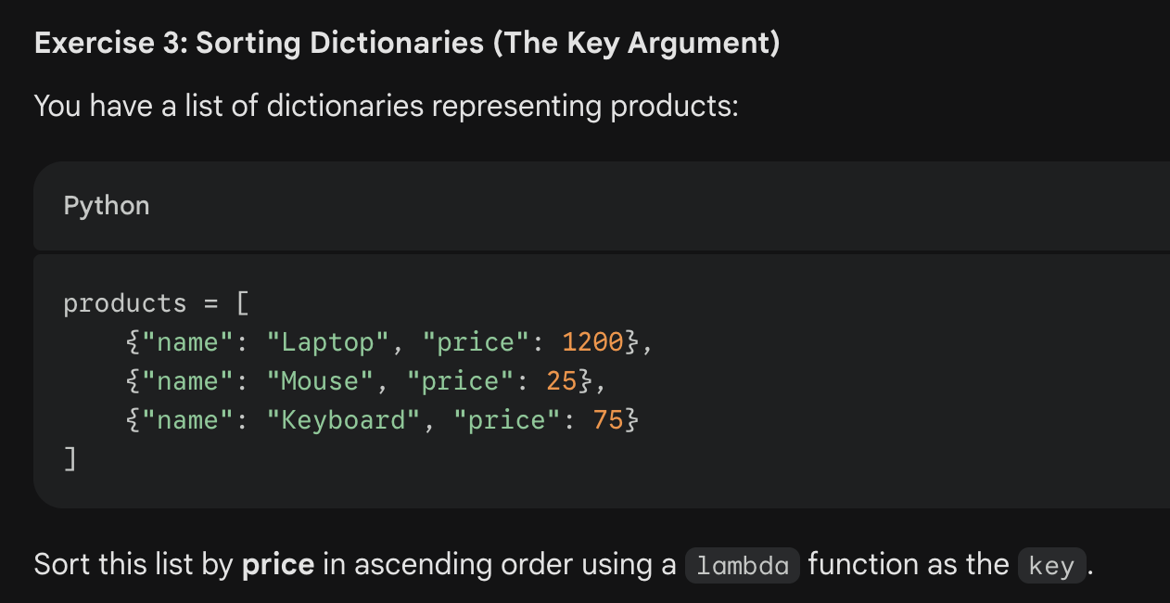
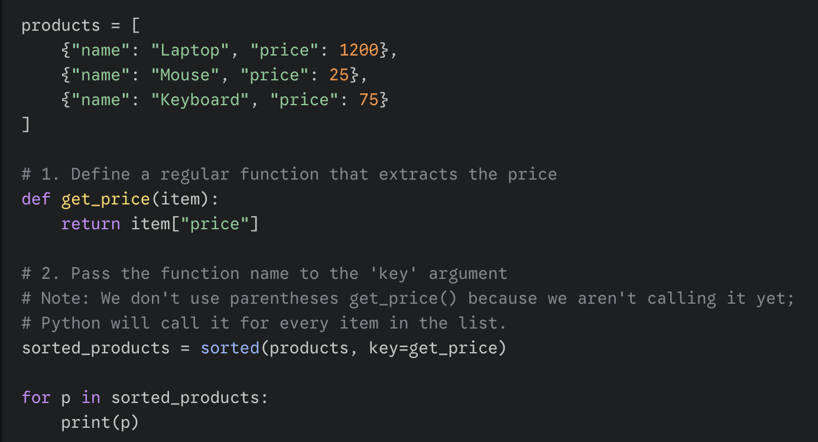
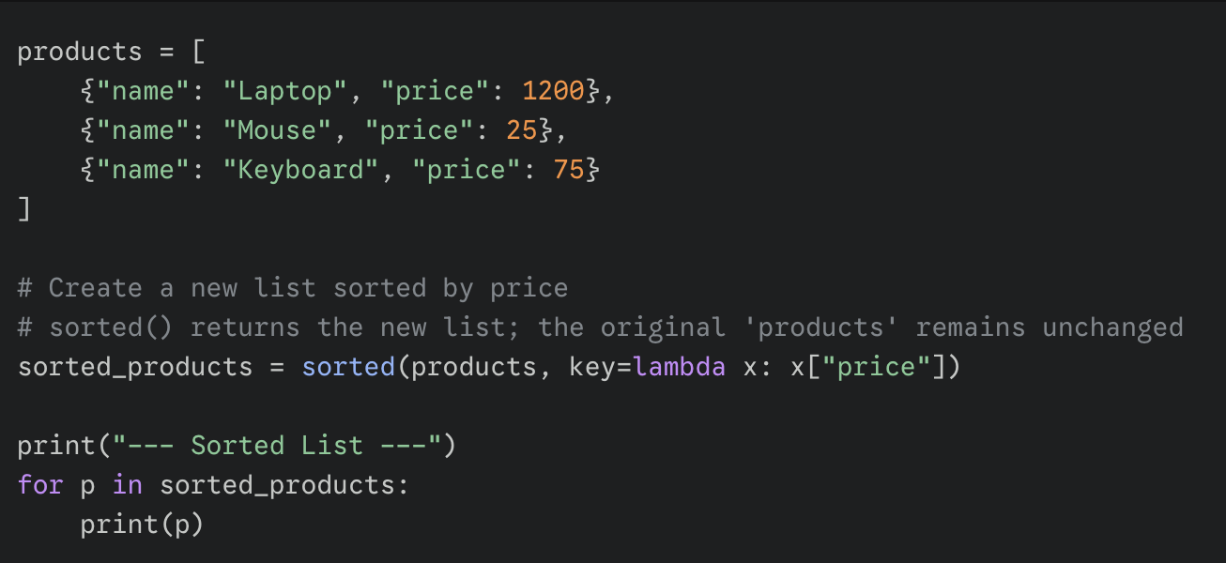
lambda is a keyword for a nameless, single-expression function used in sort

Slide 20
Sorting by Multiple Fields with itemgetter and attrgetter
• When each item contains multiple parts, such as a person’s first name, last name, and score, you often want sorting to consider more than one field in order.
◦ Example: sort by last name, then first name
• The operator module provides itemgetter and attrgetter helpers that create key functions for you, making it easy to sort tuples or objects by one or more positions or attributes.
◦ itemgetter is for indexable items like tuples
◦ attrgetter is for object attributes
• When itemgetter is given multiple indexes, it returns a tuple of those extracted values, and Python naturally compares tuples left-to-right to break ties predictably.
◦ Primary key first, secondary key second
◦ Tuple comparison is lexicographic (i.e. alphanumeric order)

Slide 21
Code Example: Multi-key sorting using operator.itemgetter
from operator import itemgetter
# (first name, last name, score) tuples
grade = [('Freddy', 'Frank', 3), ('Anil', 'Frank', 100), ('Anil', 'Wang', 24)]
sorted(grade, key=itemgetter(1,0))
# [('Anil', 'Frank', 100), ('Freddy', 'Frank', 3), ('Anil', 'Wang', 24)]
sorted(grade, key=itemgetter(0,-1))
#[('Anil', 'Wang', 24), ('Anil', 'Frank', 100), ('Freddy', 'Frank', 3)]
What are these sorting by?
Last Name, First Name sort
First Name, Grade sort

Slide 22
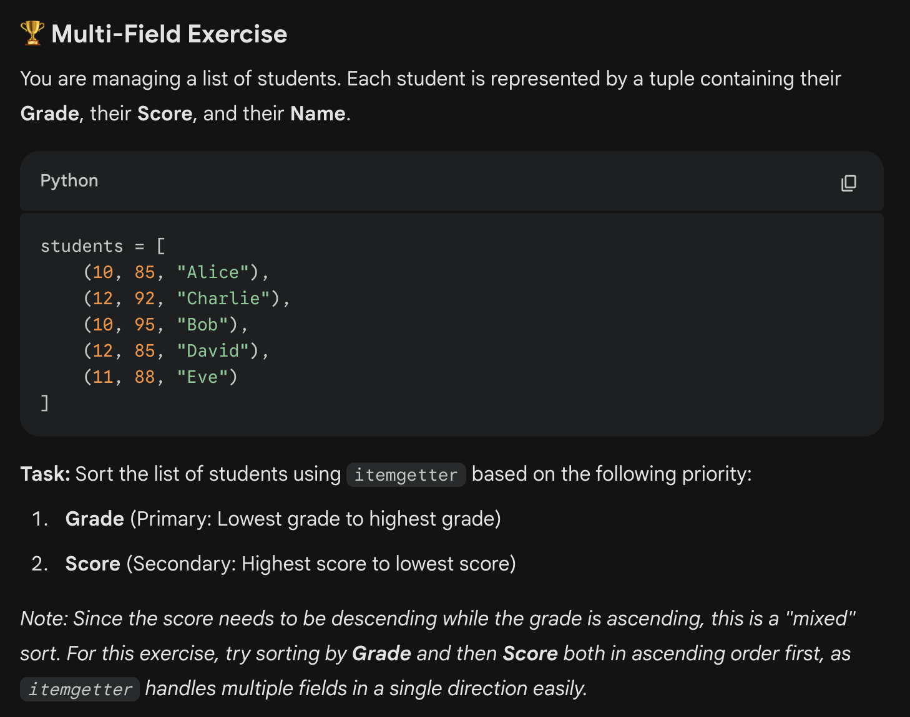
First, sort the list by the score, but in reverse order (descending)
Then, sort the list by the grade (higher priority)
Loop through the list to print out each tuple
students = [
(10, 85, "Alice"),
(12, 92, "Charlie"),
(10, 95, "Bob"),
(12, 85, "David"),
(11, 88, "Eve")
]

Slide 23
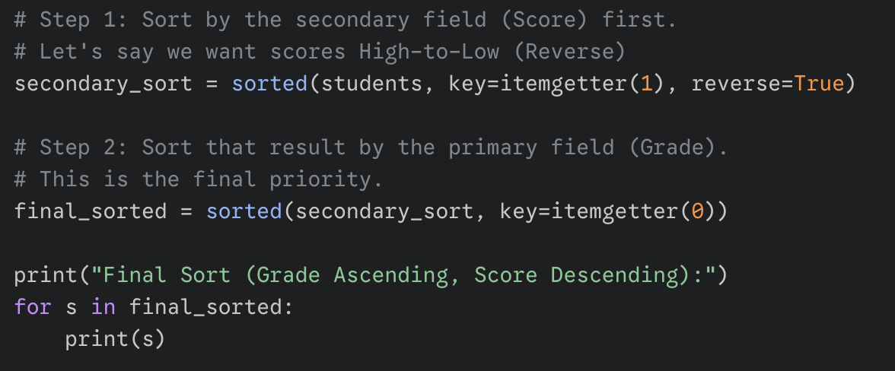
students = [
(
10, 85, "Alice"),
(12, 92, "Charlie"),
(10, 95, "Bob"),
(12, 85, "David"),
(11, 88, "Eve")
]

Slide 24
In-Place Sorting with the list.sort() Method
• Python lists also have a sort() method, which rearranges the elements of that same list into ascending order instead of producing a separate sorted copy.
◦ Called as alist.sort()
◦ Only works on lists
• A key difference is that list.sort() returns None, so you should call it as a standalone statement rather than trying to assign its “result” to a variable.
◦ Very common beginner misunderstanding
• Because sort() changes the list directly, it can be slightly faster when you already have a list and you do not need the original ordering for anything else.
◦ Avoids creating a new list
◦ May save memory
Why does this list method return None?

Slide 25
Code Example: Correct and incorrect uses of list.sort()
alist.sort() ## correct
alist = blist.sort() ## Incorrect. sort() returns None

Slide 26
Choosing Between sorted() and sort()
• Use sorted() when you want a new sorted list and you need to preserve the original sequence, because sorted() leaves the input unchanged and is easy to reason about.
◦ Works on any iterable
◦ Returns a new list
• Use list.sort() when you already have a list and you are comfortable modifying it in place, especially when performance or memory use matters in large lists.
◦ List-only method
◦ Sorts in place and returns None
• You may see sort() more often in older code because it existed before sorted(), but modern Python code frequently prefers sorted() for its clearer return behavior.
◦ Older style: list.sort()
◦ Newer style: sorted(iterable)

Slide 27
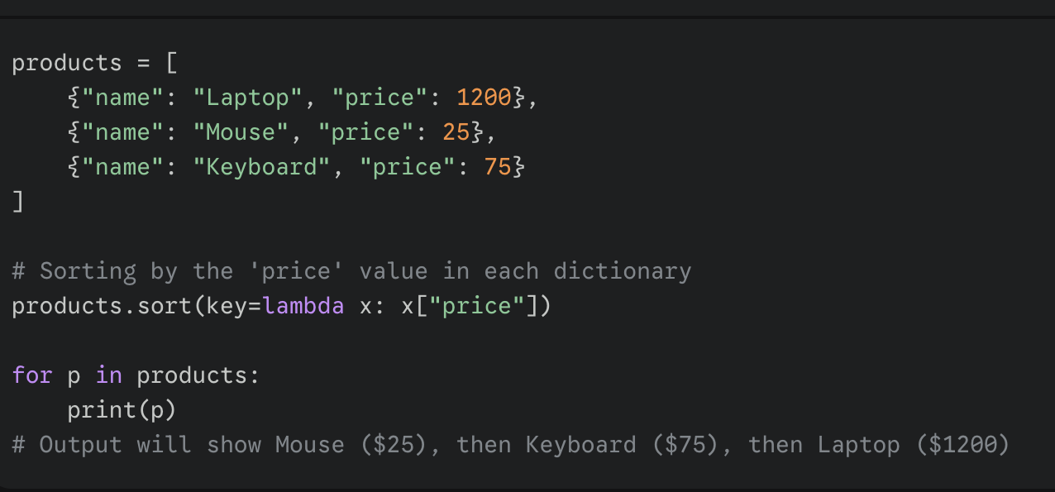
Solve this using list.sort
products = [ {"name": "Laptop", "price": 1200}, {"name": "Mouse", "price": 25}, {"name": "Keyboard", "price": 75} ]

Slide 28
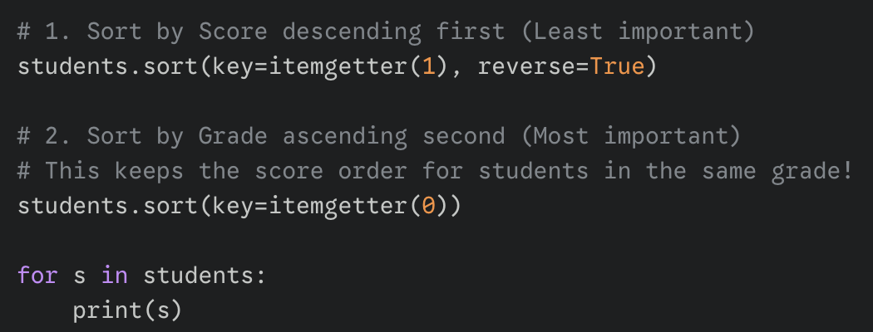
Solve this using list.sort
students = [
(
10, 85, "Alice"),
(12, 92, "Charlie"),
(10, 95, "Bob"),
(12, 85, "David"),
(11, 88, "Eve")
]
Why don’t we sort Grade first instead of Score first?
Grade has higher priority and so should determine the final sort order.

Slide 29
Tuples

Slide 30
Tuples: Fixed-Size Groupings of Values
• A tuple is a fixed-size grouping of elements, such as an (x, y) coordinate, and it is similar to a list except its size and contents are not meant to change.
◦ Written with parentheses and commas
◦ Often used for structured data
• Tuples are considered immutable, meaning you cannot assign to an individual position, although a tuple can still contain a mutable object such as a list.
◦ Immutability applies to tuple slots
◦ Contained objects may still be mutable
◦ Each record uses a consistent shape

Slide 31
Tuples contain structured data
• Tuples are commonly used like lightweight “structs” to pass small bundles of related values, and functions can return multiple values by returning a tuple.
◦ Example: return (result, errorCode)
◦ Easy multi-value returns
• A natural way to represent many fixed-format records is a list of tuples, such as a list where each element is a three-item (x, y, z) coordinate tuple.
◦ List holds many records

Slide 32
Code Example: Tuple basics and immutability
tuple = (1, 2, 'hi')
print(len(tuple)) ## 3
print(tuple[2]) ## hi
tuple[2] = 'bye' ## NO, tuples cannot be changed
tuple = (1, 2, 'bye') ## this works because you’re replacing the entire tuple with a new tuple, i.e. reassignment

Slide 33
Creating Tuples, Including the Special Case of Size 1
• You create a tuple by placing values separated by commas, usually inside parentheses, and the empty tuple is written as an empty pair of parentheses: ().
◦ Examples: (1, 2), ('a', 'b'), ()
• Reading a tuple is just like reading a list, so operations such as len(), indexing with square brackets, looping with for, and testing membership with in work the same.
◦ len(tuple)
◦ tuple[0]
◦ for x in tuple

Slide 34
One-item Tuple
• A one-item tuple requires a trailing comma to make Python treat it as a tuple rather than just an expression in parentheses, which prevents confusing syntax mistakes.
◦ ('hi',) is a tuple
◦ ('hi') is just a string in parentheses
• Creating a one-item tuple;
tuple = ('hi',) ## size-1 tuple

Slide 35
Tuple assignment without parentheses
• Python can infer a tuple from commas even without parentheses in some contexts, because the comma is what actually defines the tuple structure in the language.
◦ Parentheses may be optional in some assignments

Slide 36
Tuple Packing and Unpacking (Parallel Assignment)
When you assign a tuple to a matching tuple of variable names, Python performs unpacking by placing each value into its corresponding variable position in one step.
◦ Left side: variables
◦ Right side: tuple values
• Unpacking requires the same number of items on both sides, and Python raises an error if the sizes do not match, which helps catch mistakes early.
◦ Mismatch causes an exception
• This unpacking feature also works with lists, and it is commonly used when a function returns multiple values, allowing you to store each result in a named variable.
◦ Readable multi-value returns
◦ Common pattern: (a, b) = function()

Slide 37
Code Example: Tuple unpacking and multi-value returns
(x, y, z) = (42, 13, "hike")
print(z) ## hike
(err_string, err_code) = Foo() ## Foo() returns a length-2 tuple

Slide 38
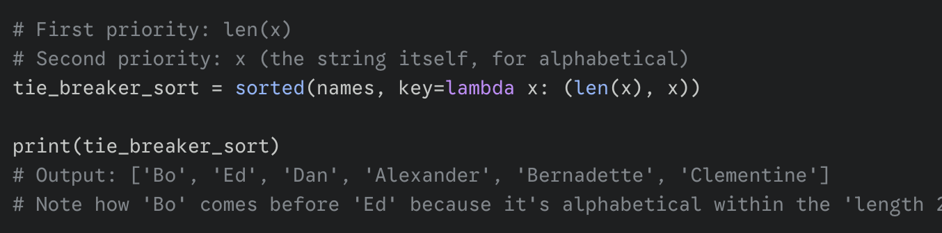
Tuple sorting example

Slide 39
List Comprehension

Slide 40
List Comprehensions: A Compact Way to Build Lists
• A list comprehension is a compact expression that creates a whole new list by applying an expression to every element in an existing list, without writing a full loop.
◦ Creates a new list
◦ Often replaces a simple for-loop
• The basic pattern is [expr for var in list], where var takes on each element value, and expr is evaluated once per element to produce the output list values.
◦ No colon at the end
◦ Looks like a loop inside brackets
•

Slide 41
Code Example: Squares using a list comprehension
nums = [1, 2, 3, 4]
squares = [ n * n for n in nums ] ## [1, 4, 9, 16]
Although list comprehensions are convenient, they are optional for beginners, and you can skip them until you are comfortable with lists, loops, and functions.
◦ Not required for early exercises
◦ Learn later if it feels too dense

Slide 42
Transforming Strings with List Comprehensions
• List comprehensions are especially readable when you want to transform every element in a list, such as converting each string to uppercase and adding extra characters.
◦ One expression per element
◦ Clear “input list to output list” flow
• In a transformation comprehension, the expression on the left of the for-clause describes how each output element is computed, while the for-clause describes where inputs come from.
◦ Left side: output formula
◦ Right side: iteration

Slide 43
Code Example: Uppercasing strings and appending text
strs = ['hello', 'and', 'goodbye']
shouting = [ s.upper() + '!!!' for s in strs ]
## ['HELLO!!!', 'AND!!!', 'GOODBYE!!!']
• Because the result is a brand-new list, the original list of strings remains unchanged unless you explicitly replace it, which helps prevent accidental data loss.
◦ Original list stays available
◦ Assign result to a new variable

Slide 44
Filtering with if in a List Comprehension
• A list comprehension can include an if condition after the for-clause, and the condition is checked for each element to decide whether that element is included.
◦ Pattern: [expr for var in list if condition]
• Filtering is useful when you want to select only certain items, such as keeping numbers less than or equal to a threshold, while leaving out items that fail the test.
◦ Example: keep values <= 2
• You can combine filtering and transformation, such as selecting only fruit names containing a particular letter and converting those selected names to uppercase in the resulting list.
◦ Example: 'a' in the string
◦ Then apply .upper()

Slide 45
New Session Starts Here

Slide 46
Code Example: Filtering numbers and strings with if
• ## Select values <= 2
nums = [2, 8, 1, 6]
small = [ n for n in nums if n <= 2 ] ## [2, 1]
## Select fruits containing 'a', change to upper case
fruits = ['apple', 'cherry', 'banana', 'lemon']
afruits = [ s.upper() for s in fruits if 'a' in s ]
## ['APPLE', 'BANANA']

Slide 47
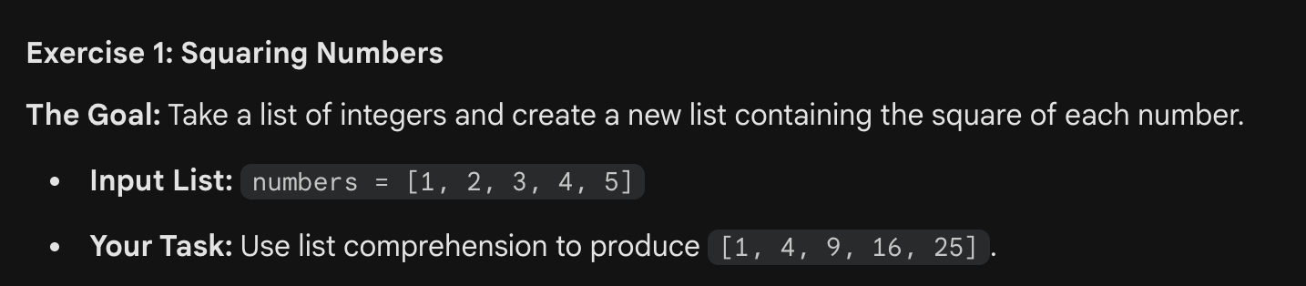
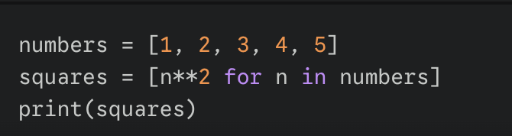

Slide 48
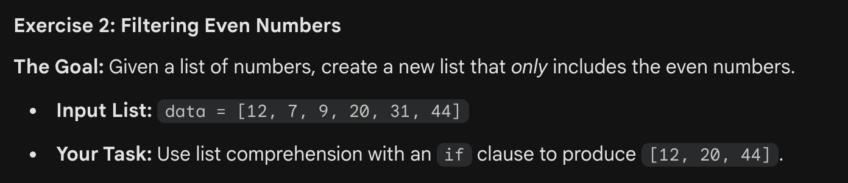
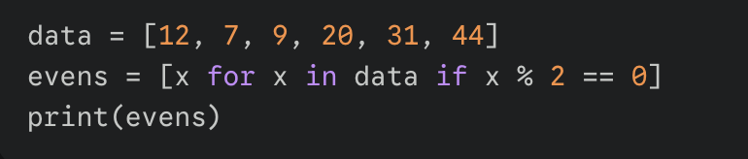

Slide 49
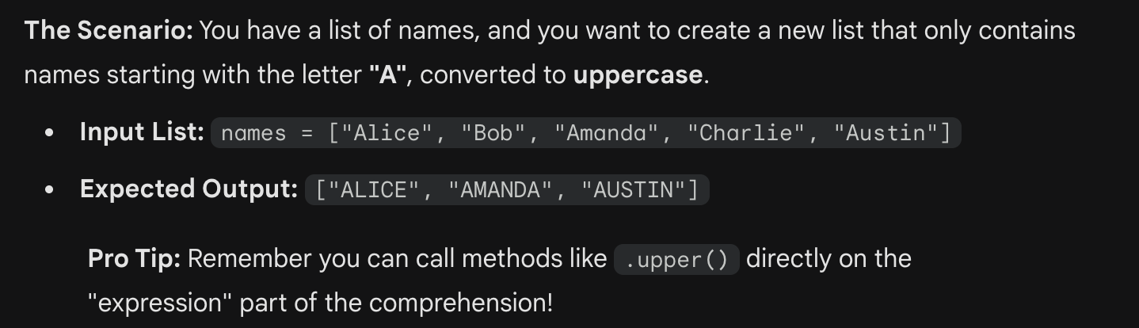
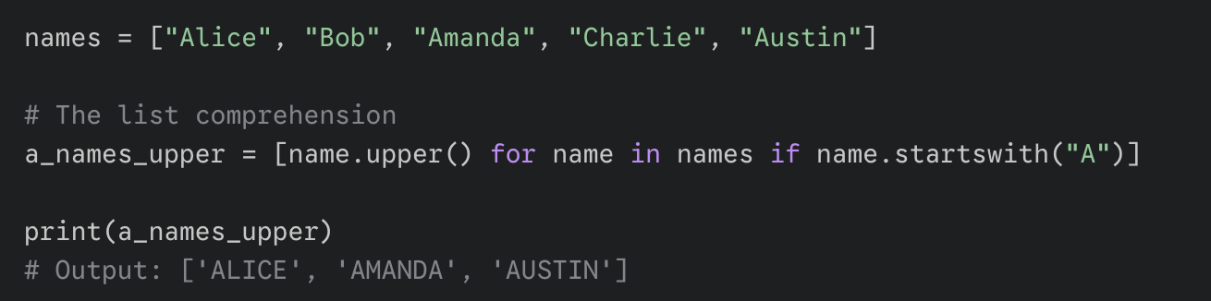
names = ["Alice", "Bob", "Amanda", "Charlie", "Austin"]

Slide 50
Practice: Applying Sorting and Tuples
• To strengthen your understanding, practice problems that combine sorting and tuples, because these topics often appear together when you are working with structured records like names and scores.
◦ Sort records by one or more fields
◦ Use tuples to represent a record

Slide 51
Sorting and Tuple Exercise
Remember in micro you can use trackpad to scroll up and down
list1.py
front_x (Hint: Use List comprehension)
sort_last (Try the lambda function trick)
◦ sorted() returns a new list
◦ sort() changes the list and returns None

Slide 52
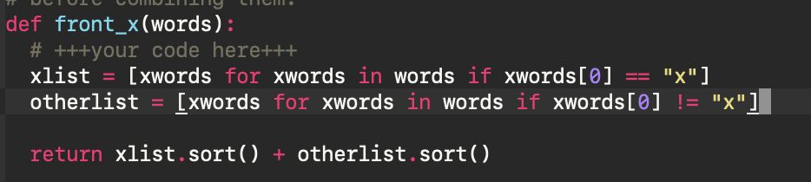
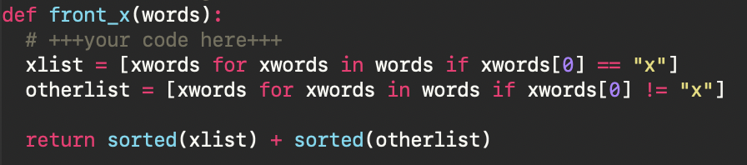
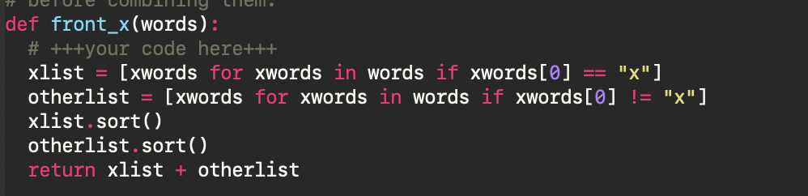
front_x (two loops using list comprehension)
What’s wrong with this code? (returns error)
remember list.sort() returns None
How you would fix using list.sort()?
Note: This is inefficiently using two loops…

Slide 53
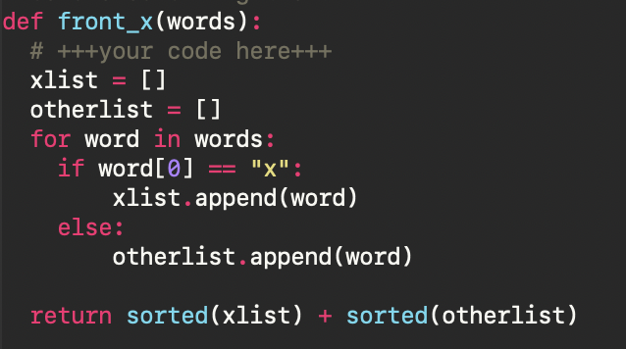
front_x (single loop)
more efficient single loop

Slide 54
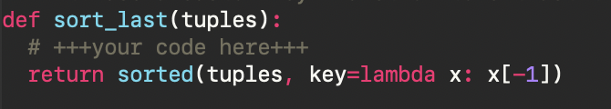
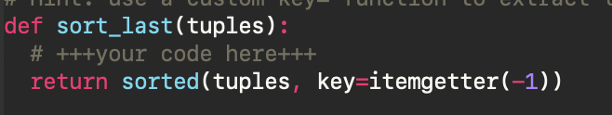
sort_last
using lambda:
is there another way to do this?
use itemgetter!

Slide 55
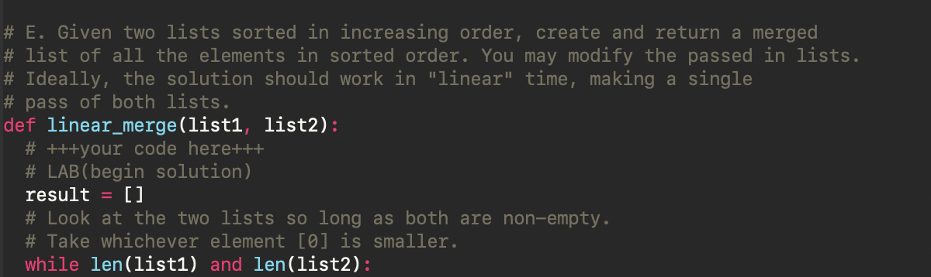
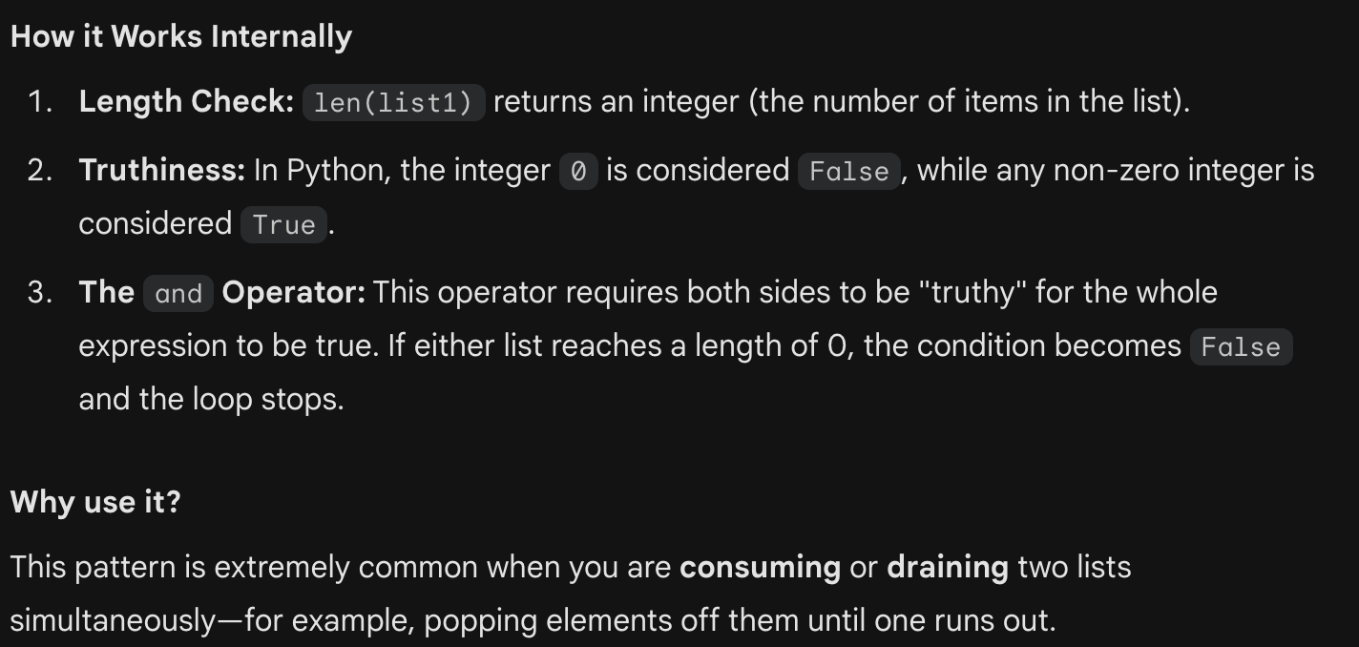
list2.py: linear_merge
if first element of list 1 is greater than first element of list 2, add that element to new list; otherwise add the other element.
Add the remaining elements from both lists.

Slide 56
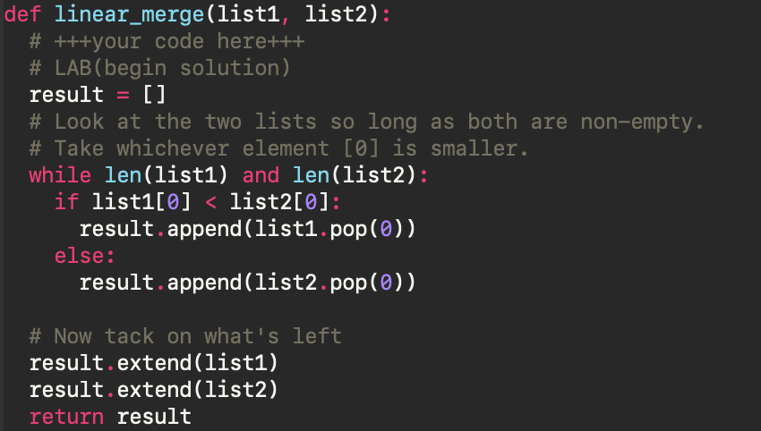
Solution to linear_merge

Slide 57
Thank you

